Slide 1
Welcome!

Slide 2
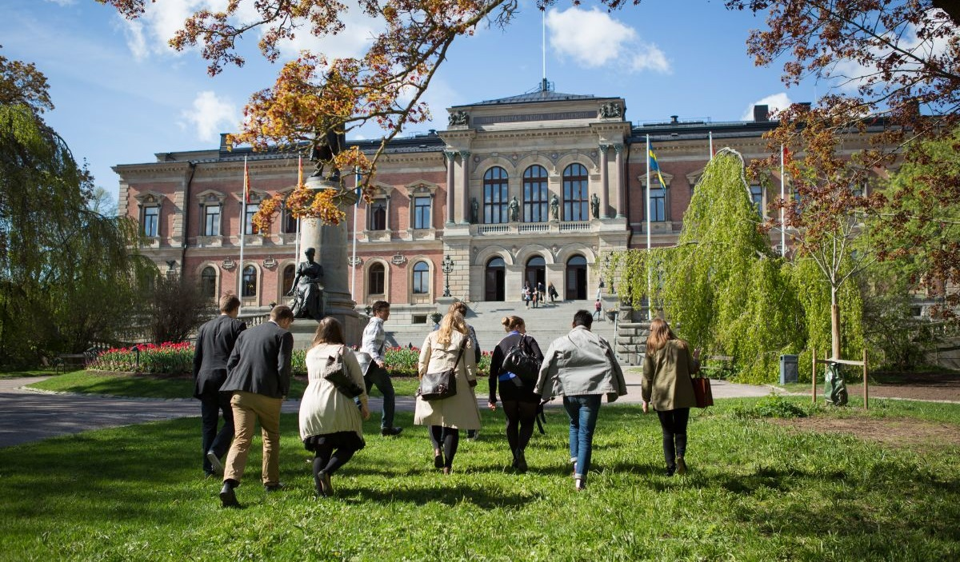
Uppsala University
The Erasmus Mundus team:
erasmusmundus@uadm.uu.se

Slide 3
Uppsala i Europa
Uppsala, Sweden
Notes:
Uppsala is located in Sweden, in the North of Europe. Sweden is a constitutional monarchy with a parliamentary democracy form of government.

Slide 4
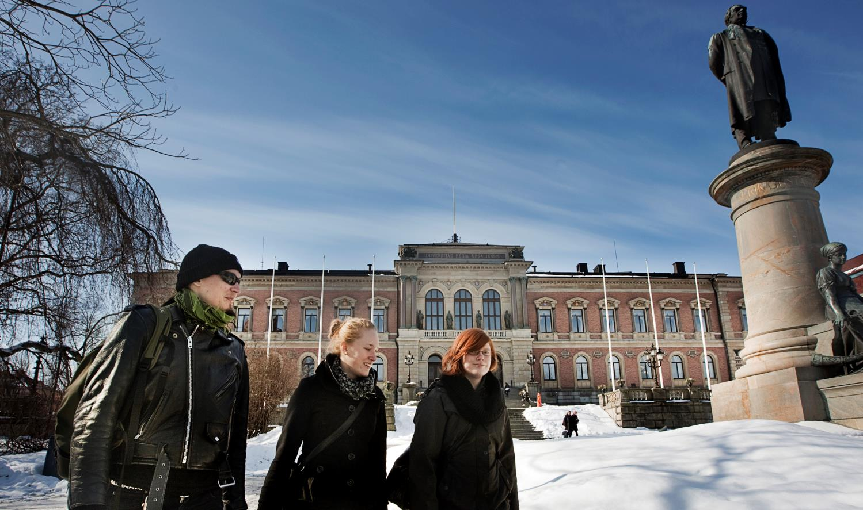
Uppsala University
The First University in Sweden
Since 1477
World Rank - Top 100
40 000 students (4 000 international)
4 500 Teachers/Researchers

Slide 5
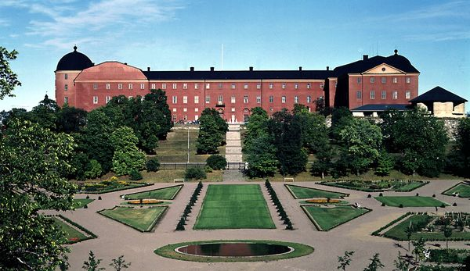
Uppsala Sweden’s 4th largest city
Notes:
Uppsala University is the oldest Nordic university – founded in 1477. It ranks among the best universities in Northern Europe and top 100 in the world.
Archbishop Jakob Ulvsson was the initator behind its establishment. In the beginning, education consisted primarily of lectures in philosophy, law and theology; there was no teaching in natural sciences or engineering.
The university rose to significance during the rise of Sweden as a great power at the end of the 16th century. Uppsala also has an important historical place in Swedish national culture, identity and for the Swedish establishment: in historiography, literature, politics, and music. Many aspects of Swedish academic culture in general, such as the white student cap, originated in Uppsala. It shares some peculiarities, such as the student nation system, with Lund University and the University of Helsinki.
Sen kan man säga något om att det här är sommar/vår för att anspela på nästa bild.

Slide 6
Ten different campus areas in Uppsala – plus one on Gotland!

Slide 7
Uppsala - Small town, big university
About 200 000 inhabitants
About 50 000 connected to the two universities (UU,SLU)
Student friendly environment - Culture, sports, entertainment

Slide 8
Campus Gotland
Part of Uppsala University since 2013
Courses for exchange students
EXTRA – some courses in Game design

Slide 9
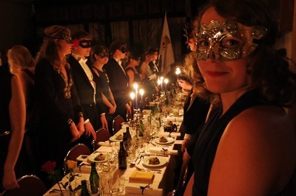
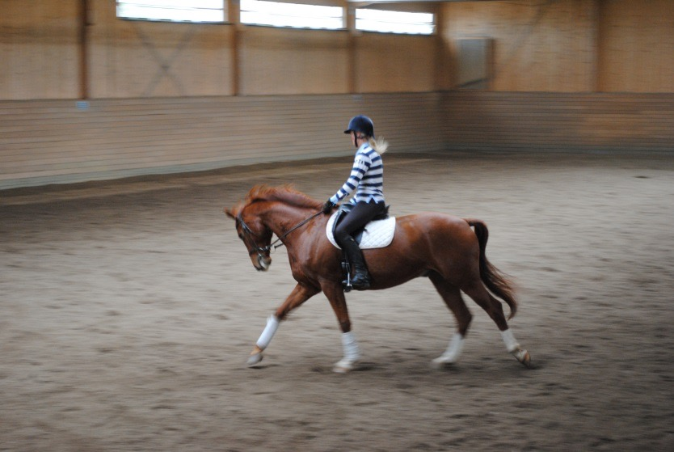
Unique student life 13 different Student Nations, many student activities and traditions, bike friendly town, sports, recreation

Slide 10
Studies Independent learning and creative thinking Teaching students to become problem solvers

Slide 11
Exchange studies
Uppsala University is part of the Erasmus Mundus scholarship program which you can apply through.
One or two semesters
More than 700 courses taught in English are available to incoming exchange students

Slide 12
How to apply
Visit the AESOP + webpage to get more information:
http://www.aesopplus.eu/
Apply to Uppsala University, please read the Application Guidelines: http://www.uu.se/en/admissions/erasmus-mundus/application-guide/
Course list for Exchange Students: http://www.uu.se/en/admissions/exchange/course/list/
Contact us if you have any questions erasmusmundus@uadm.uu.se

Slide 13
Welcome to Uppsala!
Welcome reception in the beginning of each semster.
International Student Guide
More information: www.uu.se/welcome
http://www.uu.se/en/campus/#/

Slide 14
Welcome to apply!

